Slide 1
Blockchain & Cryptocurrencies
What About You?
Catherine Austin Fitts
The Solari Report
Nexus Conference

Slide 2
Solari Report Goal: A Free and Inspired Life

Slide 3
The Solari Investment Model

Slide 4
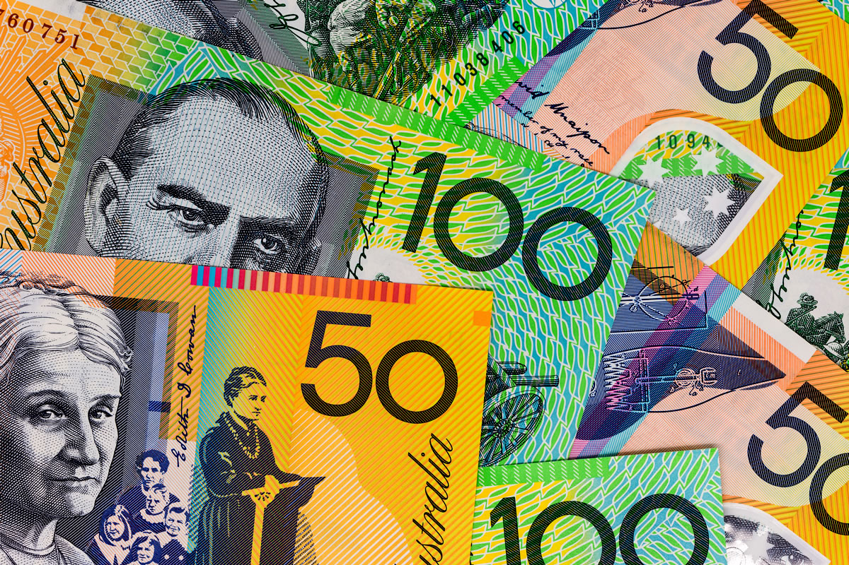
Money Systems: Cui Bono?
Money is and always has been political….Our central concern should be not with [money’s] technology, but with the political and legal framework within which it operates.
~ Dr. Rebecca Spang

Slide 5
Global Governance
Invisible
Financial System is Critical Part
Centralizing
Values: Opposed to individual and national sovereignty

Slide 6
Aaron Russo: The Governance Goal

Slide 7
Control is Analog and Digital

Slide 8
Tearing up the Peace of Westphalia

Slide 9
This Time It’s Different…..Really?

Slide 10
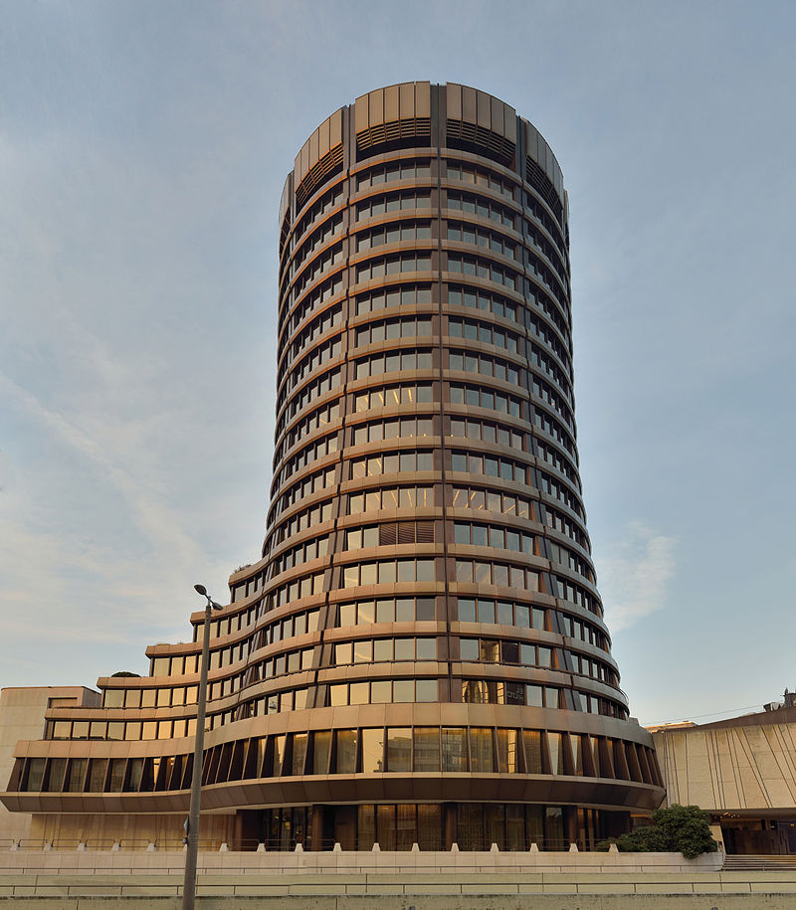
Basel, BIS & Bitcoin

Slide 11
Corporate Economy – Powered with Government Rules and Debt
Chart: Fortune Magazine

Slide 12
The Missing Money – Now $19 Trillion +

Slide 13
The Financial Coup d’ Etat: 1995-2017 ~The stories grow ever more creative~

Slide 14
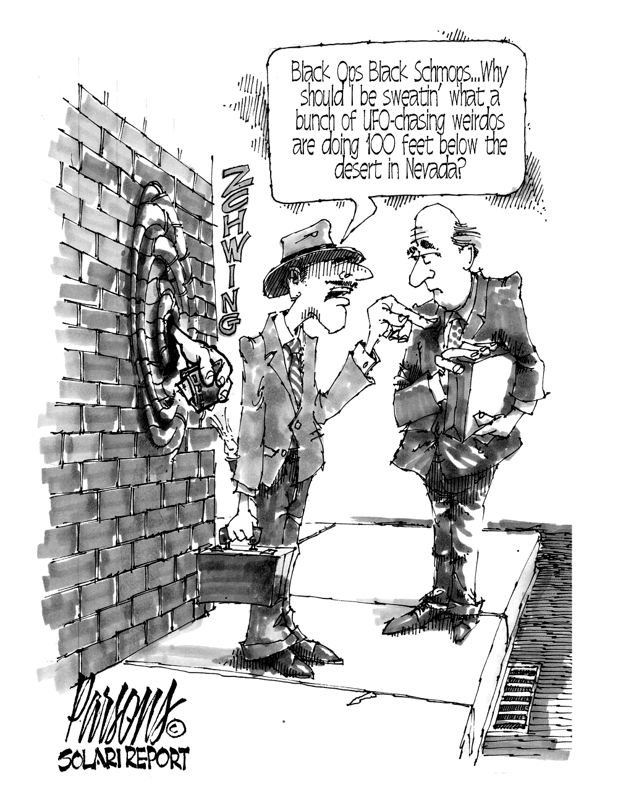

Slide 15
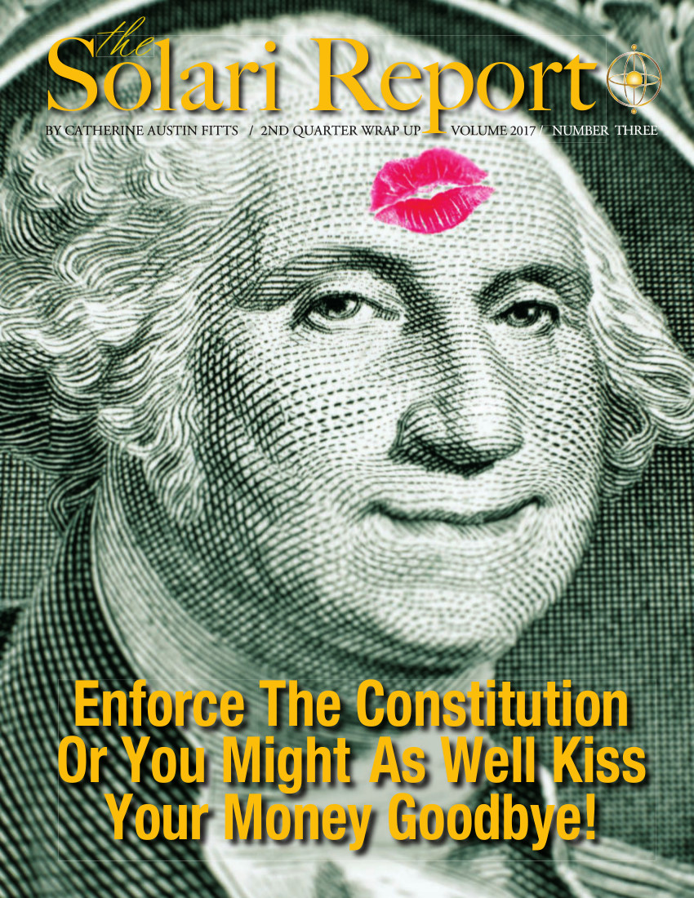
Individual and Property Rights

Slide 16
It’s Cool to Implode the Government! Or…What does abrogating millions of contracts look like?
Military pensions
Government pensions
Corporate pension insurance
Social security
Social security disability
Deposit insurance
Flood insurance
Mortgage insurance
Food stamps
Housing subsidies
Up to 50% or more in US counties…

Slide 17
Cryptocurrencies: Do I Participate?

Slide 18
Cryptocurrencies & Blockchain
Expected Growth
Bubble…Pump and Dump
Digital Insecurity
Regulatory treatment controls value
Respect the law
The rules of speculative investment
Meaningless without individual and property rights

Slide 19
Mr. Global is buying…

Slide 20
Growth Investment: Space

Slide 21
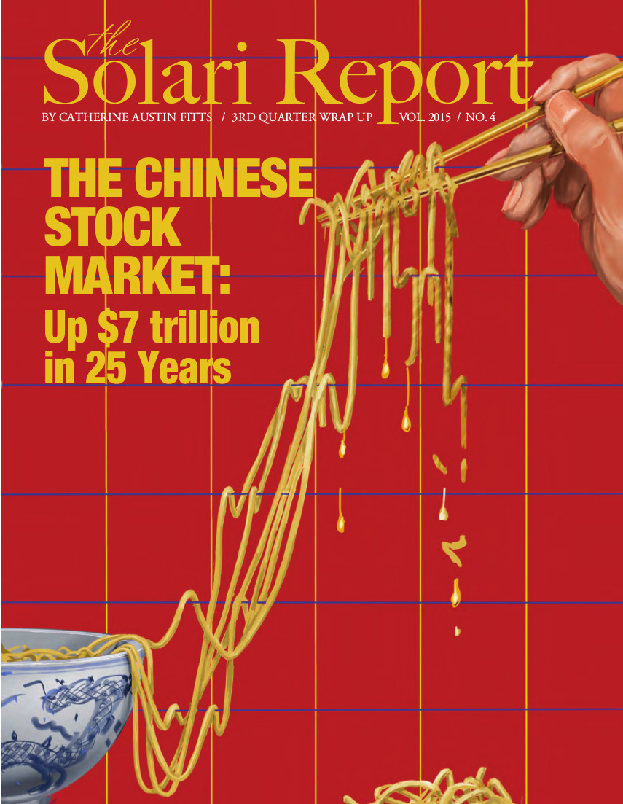
Growth Investment: Asian Convergence

Slide 22
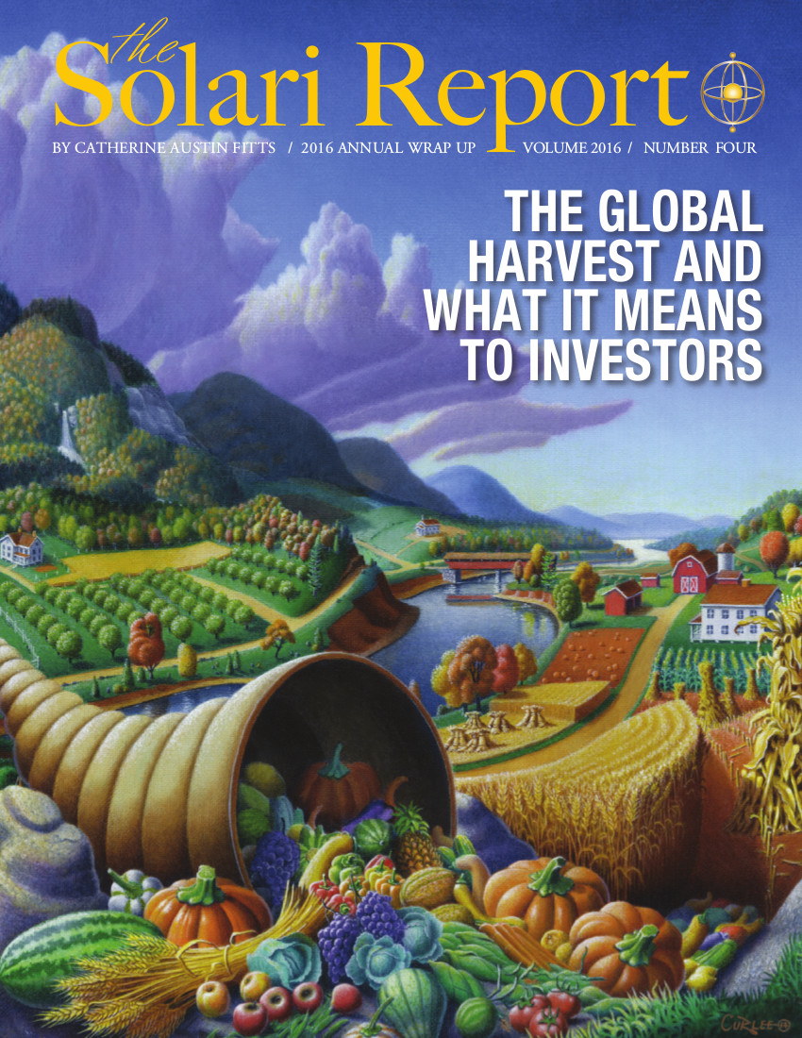
Growth Investments: Land & Water

Slide 23
The Solari Investment Model

Slide 25
The Red Button Story

Slide 26
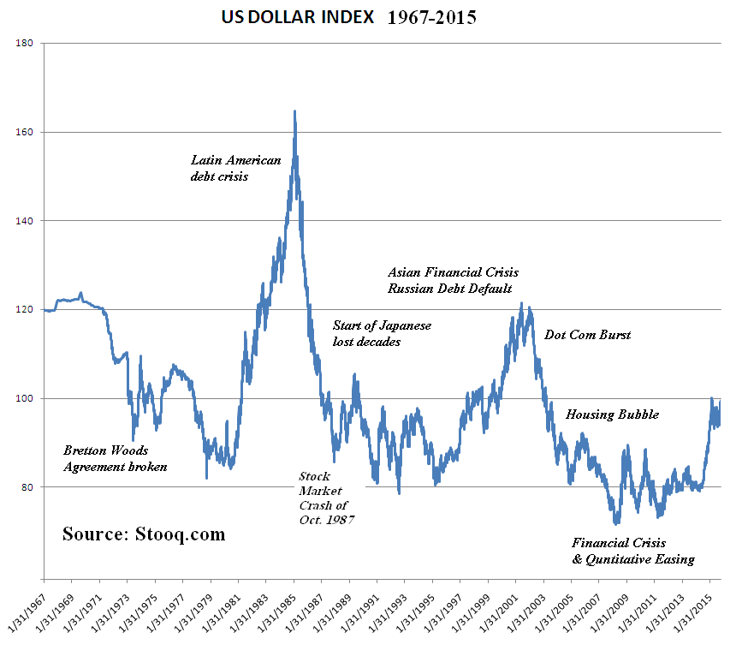
The US Dollar: Dominant & Dangerous

Slide 27
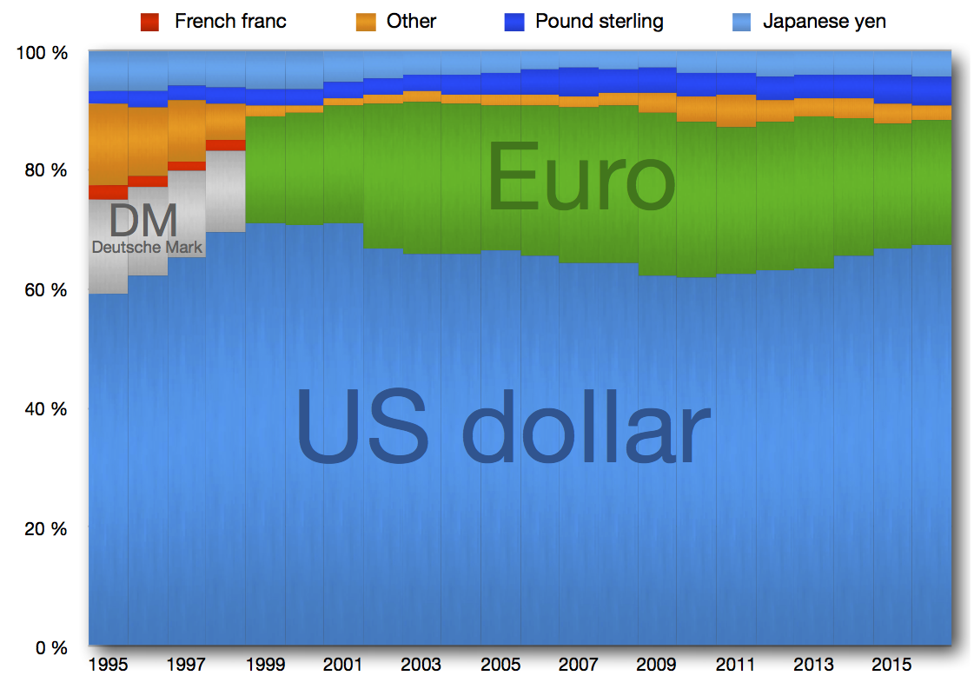
Global Currency Reserves: Dollar Dominant & Dangerous

Slide 28
Dollar Debasement: US Savers Lose Trillions

Slide 29
Global Financial Assets

